Slide 1

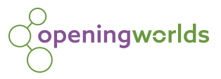
Religious Education at Priory

Slide 2
Intent
Religious Education will develop children’s knowledge and understanding of different religious traditions and cultures, which will allow them to have an awareness of the world around them. The curriculum will allow children to deepen their thinking and make connections between their lives and the lives of others. Thus enabling them to have mutual respect, understand the importance of religion and the sense of belonging. RE offers children the opportunities to reflect on their own beliefs and values along with respecting those within the school and wider community.
The key principles which underpin religious education are reflected in the two attainment targets:
Attainment Target 1 - Learning about religion
Attainment Target 2 - Learning from religion

Slide 3
Implementation
Religious education is an important aspect of a broad and balanced curriculum for all children which offers children the opportunities to look at religion through different avenues, for example;
Exploring images and stories
Discussions regarding key issues
Exploring and discussing religious artefacts
Comparing different religions and their beliefs
Acquire knowledge and an understanding of religious views and values
Understanding the importance of mutual respect, diversity and a sense of belonging
Partaking in whole school events such as Harvest Festival, school performances and religious festivals

Slide 4
Impact
Extent and further children’s knowledge and understanding of different religions and their beliefs
Develop an understanding of religious vocabulary
Contribute to discussions regarding religion and beliefs
Understanding the importance of religion and faith to individuals
Make links between their own lives and those of others in their community

Slide 5
https://openingworlds.uk/
Password – OpeningWorlds*23

Slide 6
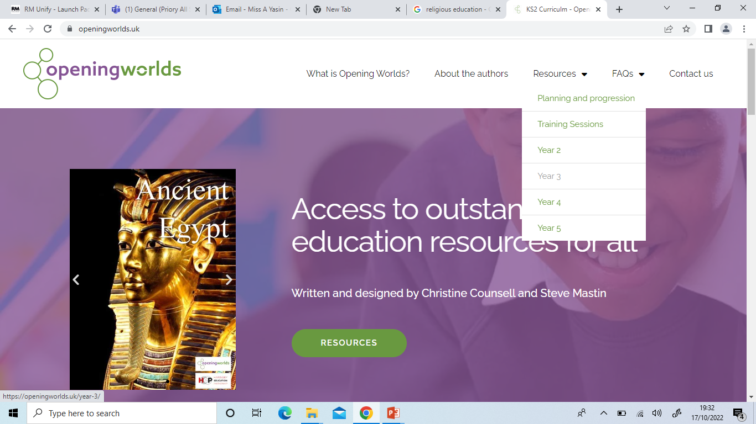

Slide 7


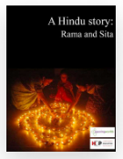
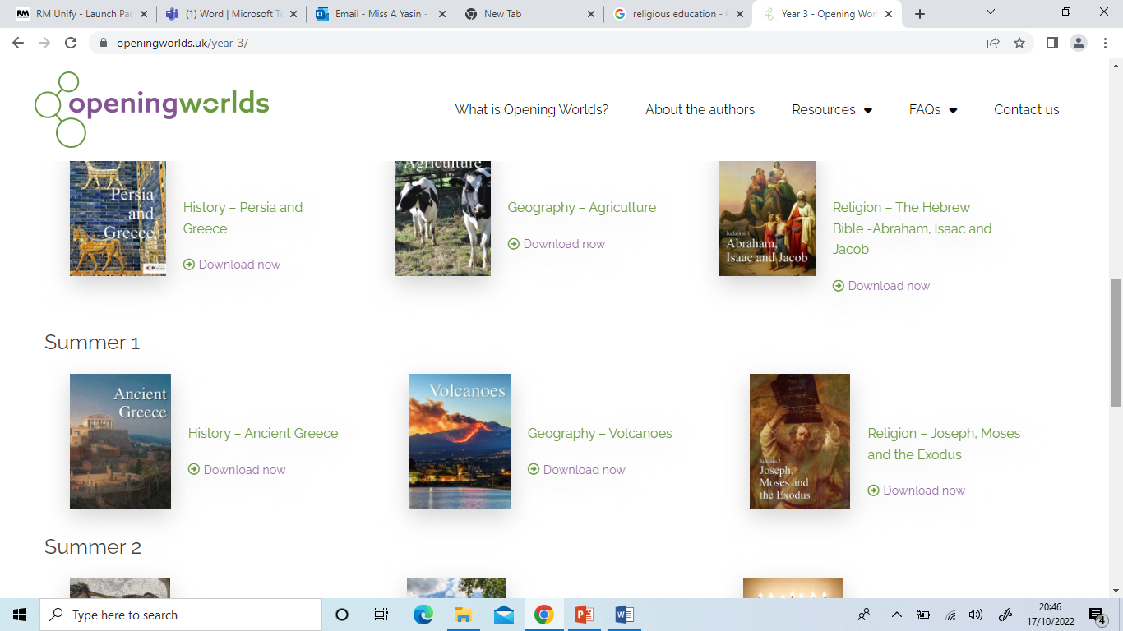
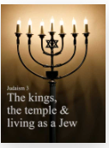
Autumn Coverage: Year 1 to Year 6
RE Overview
Term | Year 1 | Year 2 | Year 3 | Year 4 | Year 5 | Year 6
Autumn | Judaism | Judaism | Hinduism | Judaism | Judaism | Judaism
 | Theme 1 - Religion Theme 2 - Building and Rituals Theme 3 - Celebrations |  | A Hindu story: Rama and Sita | Judaism 2 - Joseph, Moses and the Exodus | Judaism 1 - Abraham, Isaac and Jacob | Judaism 3 - The kings, the temple & living as a Jew

Slide 8
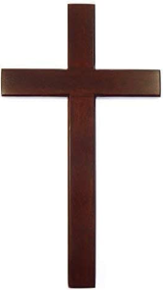
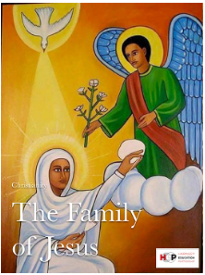
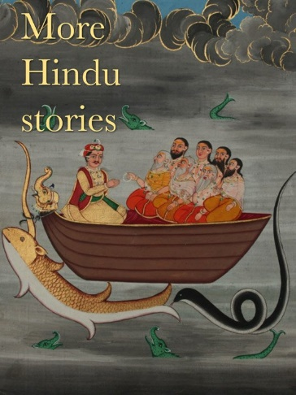
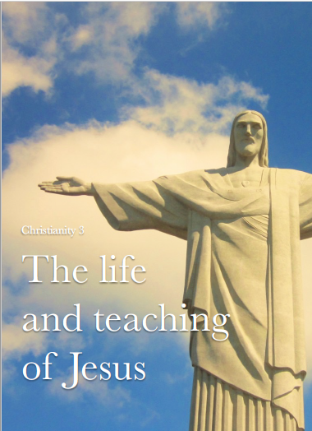
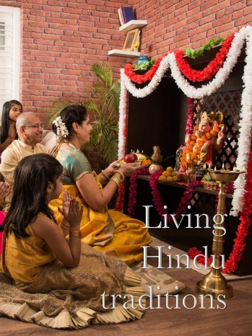
Spring Coverage: Year 1 to Year 6
RE Overview
Term | Year 1 | Year 2 | Year 3 | Year 4 | Year 5 | Year 6
Spring | Christianity | Christianity | Christianity | Hinduism | Christianity | Hinduism
 | Theme 1 - Religion Theme 2 - Building and Rituals Theme 3 - Celebrations |  | The Family of Jesus | More Hindu Stories | The life and teachings of Jesus | Living Hindu Traditions

Slide 9

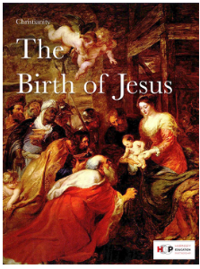
Summer Coverage: Year 1 to Year 6
RE Overview
Term | Year 1 | Year 2 | Year 3 | Year 4 | Year 5 | Year 6
Spring | Islam | Islam | TBC | Christianity | TBC | Christianity
 | Theme 1 - Religion Theme 2 - Building and Rituals Theme 3 - Celebrations |  |  | The Birth of Jesus - Currently Incomplete |  | Death and Resurrection of Jesus - Currently Incomplete

